Slide 1

INtelligent CARGO MANAGEMENT SYSTEM
P. RASHMITHA
M. SAMHITHA
D. SNEHITHA
P. SPANDANA

Slide 2
PROBLEM STATEMENT
The perishable products are to be delivered at the desirable quality in the right time to avoid food wastage during the transportation phase. The natural and physical conditions are to be considered before the movement of the goods from the source to the destination.

Slide 3
Hardware components
NODEMCU
DHT11
MQ135
FIRE DETECTION SENSOR
SERVO MOTOR
BUZZER

Slide 4
SOFTWARE
ARDUINO IDE
ANDROID(MIT APP INVENTOR)
IBM CLOUD

Slide 5
Block diagram
Compare the values in the truck with the actual values at which food shoul be stored
Selection of food products
Read temperature and humidity values in the truck from DHT11
Compare the values in the truck with the actual values at which food should be stored
If the values are out of range Send alert messages.
Read temperature and humidity values in the truck from DHT11
Air quality detection using MQ135
Fire detection
Buzzer

Slide 6
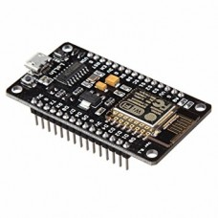
description
NODEMCU
Node MCU development board is an open-source IOT development kit. It includes firmware which runs on the ESP8266 Wi-Fi SoC from Espressif Systems, and hardware which is based on the ESP-12E module.

Slide 7
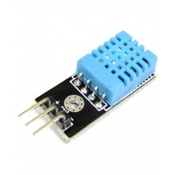
DHT11
DHT11
The DHT sensors are made up of two parts, a capacitive humidity sensor and a thermistor and gives a digital signal with temperature and humidity.

Slide 8
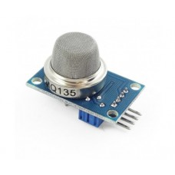
MQ135
MQ135
It is an air quality sensor for detecting a wide range of gases like NH3, alcohol and benzene. It is also sensitive to smoke and other harmful gases.

Slide 9
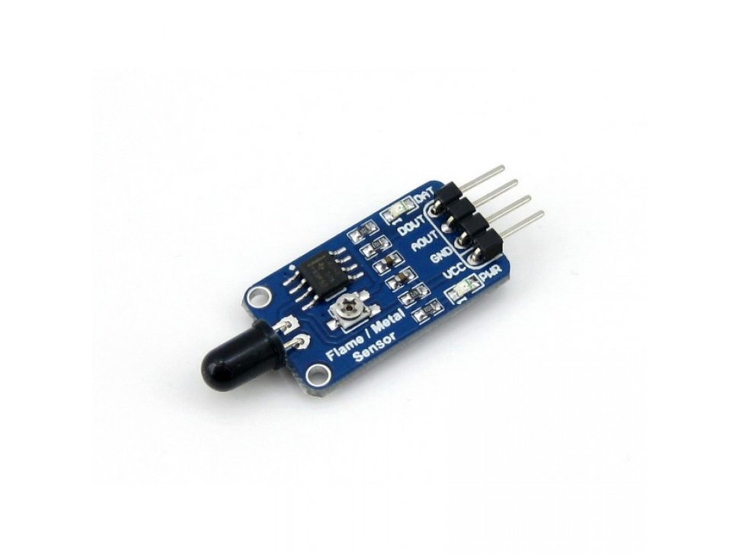
FLAME DETECTOR
FLAME SENSOR
It is a simple and compact device for protection against fire. This module makes a use of IR sensor and comparator to detect fire up to a range of one metre. An on-board is also provided for visual indication.

Slide 10
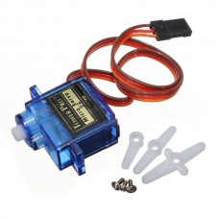
SERVO MOTOr
SERVO MOTOR
A servo motor is a rotary actuator or a linear actuator that allows precise control of angular or linear position, velocity and acceleration. It consists of a suitable motor couple to a sensor for position feedback.

Slide 11
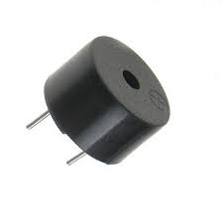
BUZZER
BUZZER
A buzzer or a beeper is an audio signaling device which may be mechanical, electro-mechanical or piezo electric.

Slide 12
PROJECT working
The sensors are deployed inside the truck to monitor the freshness of the product. Various parameters like temperature, humidity and the air quality inside the truck are monitored. An app is designed for receiving all the parameters through cloud. If the freshness level falls below the scale, then an SMS is sent to authorized person regarding the same. The door of the truck is automated using servo motor. Buzzer rings when fire is detected in the truck.

Slide 13
ADVANTAGES
Food wastage can be reduced.
Increase in safety level.
Cost savings.

